Slide 1

Lean Project Deck
Land Location Preparation
Lean Facilitator/Coach: C.C Bisike-Ojiako
Project Manager: Godian Ehirim
Project Champion: Okee Elechi/George Ezekwem

Slide 2
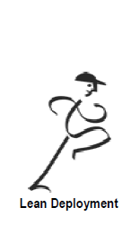
Land Location Preparation Improvement Project
Sponsor Engagement/
Approval
Map Location Preparation Process
Lean Culture
Piloting
1
4
5
2
3
Deploy Improvement Plan
Implement Just Do It Opportunities
Kaizen Event to Develop “To Be” Process/SOP
Sustain & Re-assess
Resource Lean Core Team
01 Apr – 30 April
2012
1 May – 30 May 2012
July 2012
Prepared Draft Charter
Project approval by Sponsor
Core team resourced
Hold kick off meeting
Process Walk
Build Value Stream Map
Identify & prioritize opportunities
Kaizen Event to Develop “To Be” Process
Imbed SOP
Imbed leader Standard Work
Create CI Time
Imbed Visual measures

Slide 3
Outcome
Hard Benefits
  Cycle Time reduction:
Cycle Time reduction from 8months to 5months (37.5%)
Potential cost savings of F$ 4.9mln
Soft Benefits
  Motivated workforce & Stress reduction
  Improved Environmental performance; Improved Reputation
  Reduced Exposure to HSE risks

Slide 4
Project Charter: Lean on Land Location Preparation
PROJECT OWNERSHIP
PROJECT STATUS
G
Y
R
On Track
Delayed
Stopped
  Business Unit: Engineering
  Project Sponsor: Okee Elechi
  Project Manager: Godian Ehirim
  Lean Facilitator: Chucks Bisike-Ojiako
Overall % Compl
Start Date
Completion Date
% Compl
Health
  Team Members:
  1 Engineering: (G. Warde/ Inno Chigbu)
  2. Wells (Amos Trost/ John Musa)
  3. Development (Forster uzoho)
  4. Environment (Chukwuka Amos-Ejesi)
  5: C &P (Francis Wilcox)
Pre-identify
01/04/12
Identify
30/04/12
Improve
01/05/12
31/05/12
Sustain
01/06/12
30/06/12
Close
05/07/12
BUSINESS CASE
In dry land, it takes an average of 8 months to prepare a typical location with associated access road at a cost of circa fUSD4m. In seasonally flooded land areas, it takes circa20months at a cost of circa fUSD11m due to sand filling and piling works. There is therefore little or no flexibility in location readiness with changing rig programme.
BENEFITS
  Gross Hard Benefits:
Efficiency in location preparation will reduce schedule (Cycle Time) by 30% (54 – 135days) and cost by 30% (1.2m- 3.3m USD). It will in addition support faster maturation of new projects as well as increased production of oil and gas
  Soft Benefits:
  - Save time for value added work
  Improved process and efficiency
On-time delivery
Improved relationship b/w Wells and Engineering
OPPORTUNITY STATEMENT
With current 6 rig programme in 2012 and 2013 requiring about 30 Land locations annually, opportunity exists to reduce schedule (cycle time) and cost through optimisation of the requirements and processes for location preparation. This will support faster maturation of new projects as well as increased production of oil and gas.
SCOPE
  IN:
Land Location preparation process review
Loc Pre Cost and schedule review
Implementation of earlier report (Cluster).
  OUT:
  Swamp Location Preparation
  Land take review
  Rig contract review
  Location preparation contract review.
GOAL
POTENTIAL ROADBLOCKS / ISSUES
Reduce schedule (Cycle Time) for location preparation by 30%
Reduce cost of location preparation by 30%.
Seek opportunity to reduce land take for capital locations.
Availability of nominated team members

Slide 5
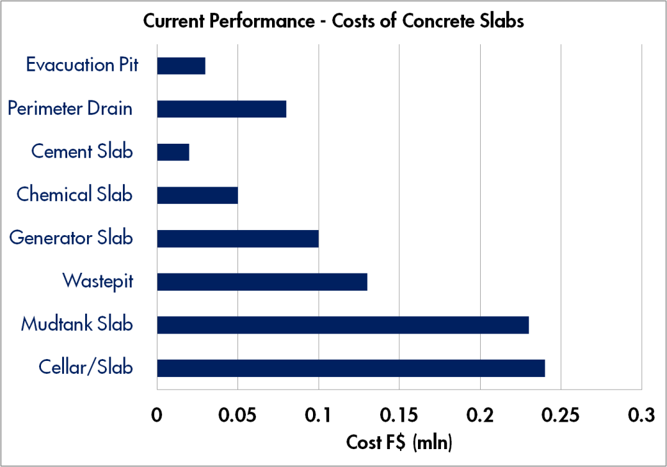
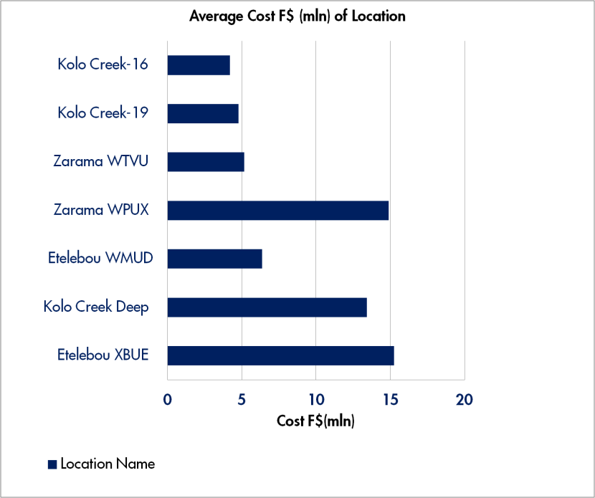
Current Performance
It takes an average of 8 -10 months to deliver a location in dry land at a cost of $4million.
In seasonally flooded areas, the indices average 18months @ $11million due to piling and deep sand filling above flood level for all season access and well integrity.

Slide 6
Voice of the Customer
Customer (Internal & External) | Key Issues (How the customer expresses it) | Requirements (what the customer wants)
Wells | *Location access road bad or delay in repair - increases rig move duration/reduces rig utilisation (higher string months) *EIA not ready or expired – results in rig shut down/NPT * Waste management approvals delayed - due to discrepancy with approved EIA (poor upfront work) *Location rework to lay flow line to cellar pit, etc – limited by existing design and due to un-optimise initial consultation with Engineering/Wells (header position, WH orientation, etc). Result in higher cost, rig delays, etc * Bent stove pipe pilled by Engineering (Gbaran field) – offline activity, now part of rig scope reducing utilisation | Location access road readiness be included in yardstick for determining location status A thorough process flow review and overhaul required to remove bottlenecks with EIA Location design modification required i.e., horizontal slots incorporated for flowline placement. Better upfront consultation required Wells/Engineering to revisit this great opportunity to view for restoring benefits through a stage implementation planned
Land Preparations (Eng) | Frequent changes in STDWS Non standardisation of rig template/requirements Late land acquisition Late release of wells (workover locations) Protracted FTO discussions Frequent community disruptions | Stable STDWS Standardisation of rig template/requirements Early land acquisition Early release of wells (workover locations Cordial community relationship
Environmental | EIA considerations are not carried along when planning for projects | As soon as the project are in the identify/assess stage on the ORP, EIA team should be notified EIA so that all regulators can be carried along and timely approvals gotten.

Slide 7
Voice of the Customer
Customer (Internal & External) | Key Issues (How the customer expresses it) | Requirements (what the customer wants)
Logistics Equipment Premob | Inaccurate and incomplete documentation Non ready transportation to premob location Failure to rectify defects within 10 days after defect notice had been issued
Security | Inaccurate and incomplete documentation
Community FTO | Non provision of FTO requirements in project PO Non early engagement of community FTO team to allow for lead time in engagement

Slide 8
Current State TIMWOOD Observations
Area | TIMWOOD Observations/Bottlenecks | Impact
Haulage | Haulage of sand and granite over long distances to site | increase transportation safety risks, standby time and impacts on cost and schedule
Haulage | Haulage of Asphalt over long distances to site | Increase transport safety, risks, standy time and impact son quality of asphalt, cost and schedule
Haulage | Haulage of Durabase materials over long distance to site | increase transportation safety risks, standby time and impacts on cost and schedule
Haulage | Current pricing of Durabase materials to site | High cost impact
Pre Mob | Poor project documentation (HSE, Equip, Security plan, JHA) by contractors | Delay in issuance of PreMob certificate and cost impact
Pre Mob | Late Delegation of Budget | Delays in issuance of PO and commencement of work with cost implication
Pre Mob | Late approval of Security plan by ASA and relevant signature | Reduces project time window and effective utilsation of dry weather window with cost impact
Pre Mob | Late issuance of contractor EQUIP premob sticker | Reduces project time window and effective utilsation of dry weather window with cost impact
Pre Mob | Late securing of LTO | Reduces project time window and effective utilsation of dry weather window with cost impact
Actual Construction | Flooding of existing Location | Stoppage of drilling whichimpacts on schedule and with attendant HSE risks
Actual Construction | Use of incompetent Contractors | Poor work quality leading to reworks and extended schedules with associated cost impact

Slide 9
Current State TIMWOOD Observations
Area/Function | TIMWOOD Observations/Bottlenecks | Impact
Actual Construction | Unstable STDWS | Increase in construction cost, impacts on timely location readiness with potential rig downtime costs
Actual Construction | Non availability of ready information (as built drawings, design & geotechnical reports, etc) | Restricts use of existing locations for drilling new wells. Cost impact
Pre Mob | Late removal of surface lines by asset engineering team | Delay in project delivery and increase in project cost due to equipment standby
Pre Mob | Late well securing by well engineering | Delay in project delivery and increase in project cost due to equipment standby
Actual Construction | Frequent community interruptions | Stoppage of work, project delivery delay and cost increase
Actual Construction | Partial implementation of clustering of wells | Increased location preparation ccost and increased schedule
Actual Construction | Extensive concrete works | Increased cost
Actual Construction | Breakdown of pilling hammer/rig | Delay in rig move with associated costs
Actual Construction | Poor condition of field roads | Delay in location preparation delivery and high costs

Slide 10
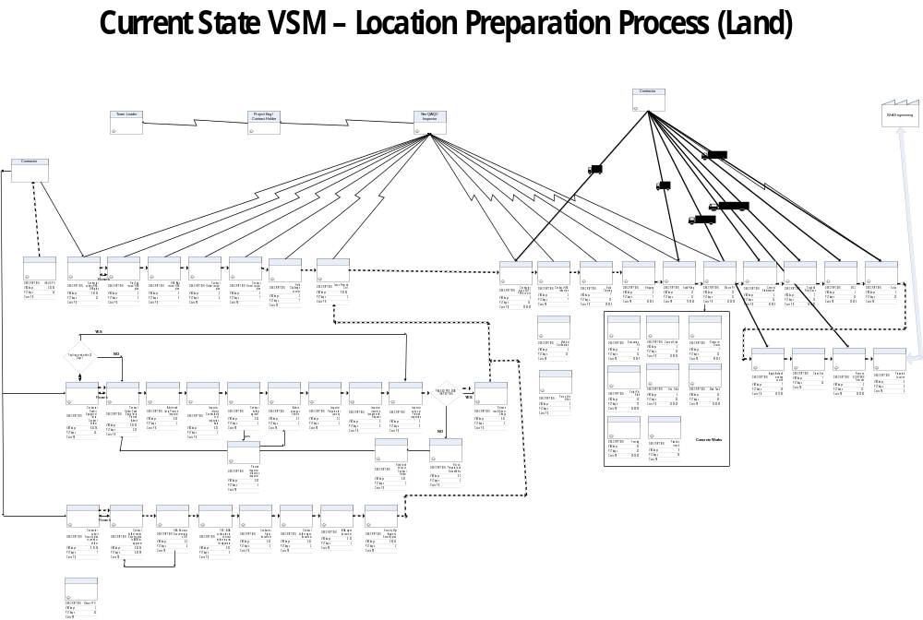
Current State Process Map/ VSM

Slide 11
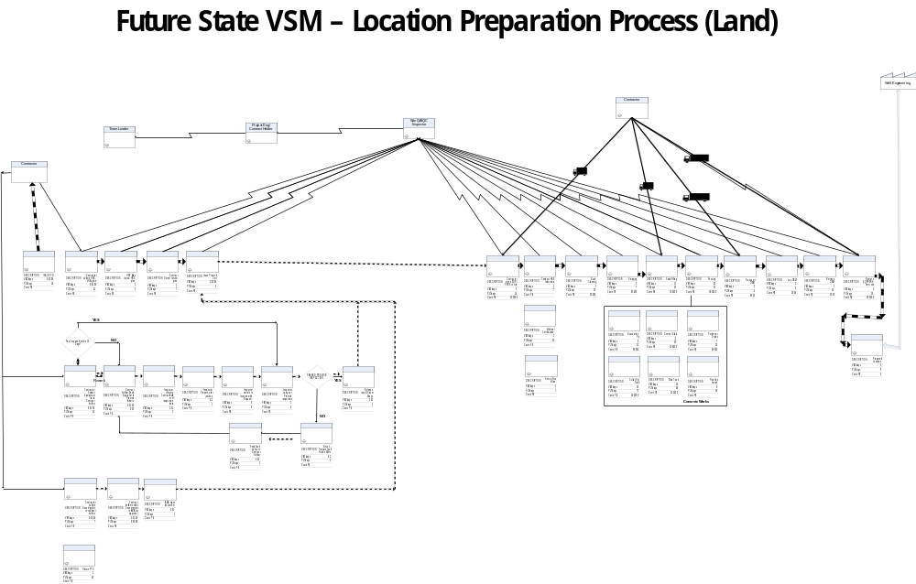
Future State Map (After Improvement)

Slide 12
RECOMMENDATIONS
S/n | Recommendation | Schedule Reduction (days) | Cost Savings (f$) | Action Party | Target
 | PREMOB
1 | Improve the time taken to secure FTO (from 42 days to 30 days) | 13 | 0 | SD | Immediate
2 | Improve on time taken to review project security plan (28 days to 4 days ) | 21 | 0 | Security Dept | Immediate
3 | Improve on time to review project HSE plan (39 days to 5 days) | 34 | 0 | HSE & Civil Engineering | Immediate
4 | Carry out equipment inspection within 3days of premob request and issues report & sticker within 2 days thereafter. | 39 | 0 | Logistics team | Immediate
5 | Improve time to secure wells for existing locations | 14 | 0 | Well Services | Immediate
6 | Improve time to remove flowlines in existing locations | 14 | 0 | Asset Engineering | Immediate
 | HAULAGE
1 | Issue PO to Contractors with asphalt within 60km of site. Deviation subject to TPE approval. | 6 | 0 | Civil Engineering | Immediate
2 | Relocate a set of Dura Base Materials to Gbaran field and retain a set in Kidney Island for quick intervention and reduction of logistics cost (space req10m x30m) | 5 | 60,000 | Civil Engineering & Prod Asset team | 31/08/2012
3 | Change pricing unit for haulage of Dura base mat from “per pc” to per “standard truck”. (save f$3000 per trip) | 0 | 120,000 | Civil Engineering & SCM | In replacement contract
4 | Use Logistics contracts for transportation of Dura base materials. | 0 | 250,000 | Civil Engineering | immediate

Slide 13
RECOMMENDATIONS
S/n | Recommendation | Schedule Reduction (days) | Cost Savings (f$) | Action Party | Target
 | CONSTRUCTION
1 | Enforce Clustering as the default option in location preparation. Deviation shall be subject to VP-Technical’s approval. | 245 | 4,000,000 | Development | Immediate
2 | Use Dura Base mat in campaign mode and when location is not planned to be revisited in the near future. Deviation subject to TPE approval. | 34 | 342,000 | Civil Engineering | Immediate
3 | Eliminate concrete generator slab and chemical slabs and replace with asphalt surface. | 30 | 78,000 | Civil Engineering | Immediate
4 | Eliminate waste pit. Change current waste management approach to pitless model. | 36 | 88,000 | Wells | Immediate
5 | Contractor to provide spare piling hammer as a standard condition for piling work. | 14 | 0 | Civil engineering | In replacement contracts
 | OTHERS
1 | Release budget early for all location in the sequence to enable early commencement
2 | Improve (standardise) Rig selection strategy and stabilise drilling sequence.
3 | Carry out concrete slab requirements review in line new tech developments and DPR req

